Slide 1


Raúl Sanz Jodar
23/03/2024

Slide 2

Outline
Executive Summary
Introduction
Methodology
Results
Conclusion
Appendix

Slide 3
Executive Summary
Summary of methodologies
Data Collection with API and Web Scraping
Data Wrangling
Exploratory Data Analysis with SQL and Data Visualization
Interactive Maps with Folium and interactive Dashboard with Dash and Plotly
Predictions with Machine Learning Algorithms
Summary of all results
ES-L1, GEO, HEO, and SSO orbits exhibit the highest success rates.
KSC LC-39A is the most successful launch site.
The Decision Tree is the best machine learning model for the project.

Slide 4
Introduction
Project background and context
The commercial space age is here. One of the most successful company is SpaceX, thanks to its relatively inexpensive rocket launches.
SpaceX advertises Falcon 9 rocket launches on its website with a cost of $62Million, while other providers cost more than $165Million, much of the savings is because SpaceX can reuse the first stage.
Key objectives
Investigate the correlation between mission parameters and their influence on landing outcomes.
Determine the probability of reuse the first stage, i.e., the optimal conditions to achieve successful landings.

Slide 5

Section 1

Slide 6
Methodology
Executive Summary
Data collection methodology:
SpaceX launch data gathered from SpaceX REST API and Web Scraping Wikipedia.
Perform data wrangling
Apply One-hot encoding in ‘Outcome’ to convert it into binary feature
Perform exploratory data analysis (EDA) using visualization and SQL
Perform interactive visual analytics using Folium and Plotly Dash
Perform predictive analysis using classification models
How to build, tune, evaluate classification models

Slide 7
Data Collection
We have two datasets, one with SpaceX data collected directly from SpaceX REST API. The other one represents the Falcon 9 launch records and has been collected via web scraping the Wikipedia.
Gather data from SpaceX API
Get the JSON from response and convert it in DataFrame
Clean data, filter and fill missing values
Webscrap Falcon 9 from Wikipedia with BeautifulSoup
Create a DataFrame with HTML tables
Convert both DataFrames in CSV

Slide 8
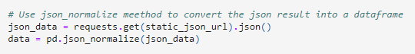
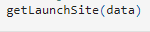
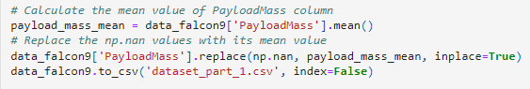
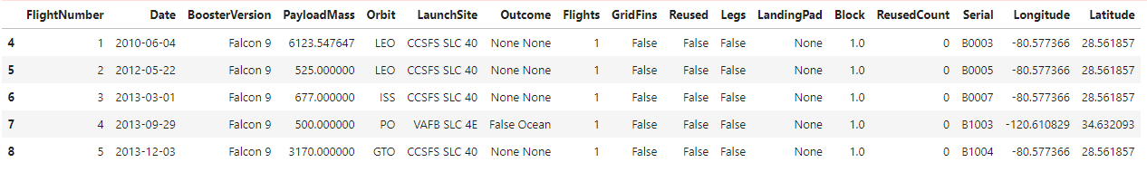
Data Collection – SpaceX API
Get response from API
Convert the response to DataFrame
Complete data via the API using id numbers
Clean and filter data
Deal with missing values
Export it to a CSV file
SpaceX API calls notebook

Slide 9
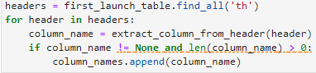
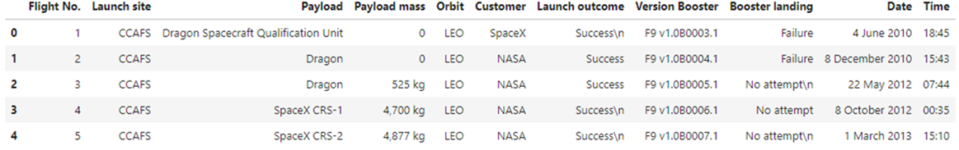
Data Collection - Scraping
Get response from Website
Create BeautifulSoup from response
Find the launch table and column names
Create dictionary and parse the data into it
Convert dictionary to DataFrame
Export it to a CSV file
Init launch_dict with empty lists and add new columns
Parse tables from soup to fill up the launch_dict
Web scraping notebook

Slide 10
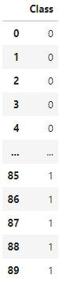
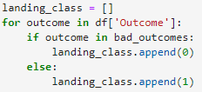
Data Wrangling
Load CSV data into DataFrame
Identify missing values and types
Calculate the number of launches per site
Calculate the number and occurrence of each orbit
Calculate the number and occurrence of mission outcome of each orbit
Create a landing outcome label from Outcome column
Export it to a CSV file
Data wrangling notebook

Slide 11
EDA with Data Visualization
The charts that have been plot are:
Scatter plot to find relationship between features and try to predict the features that leads to successful landings:
FlightNumber vs. PayloadMass
FlightNumber vs. LaunchSite
PayloadMass vs. LaunchSite
FlightNumber vs. Orbit
PayloadMass vs. Orbit
Bar chart to determine which orbits have the highest probability for successful landing:
Orbit vs. Success Rate (mean Class)
Line chart to see how the trend changes over time and make predictions:
Date vs. Success Rate (mean Class)
EDA with Data visualization notebook

Slide 12
EDA with SQL
Some of the SQL queries performed to get insights of the data are:
Display the names of the unique launch sites in the space mission
Display the total payload mass carried by boosters launched by NASA (CRS)
Display average payload mass carried by booster version F9 v1.1
List the names of the boosters which have success in drone ship and have payload mass greater than 4000 but less than 6000
List the total number of successful and failure mission outcomes
List the records which will display the month names, failure landing_outcomes in drone ship, booster versions, launch_site for the months in year 2015.
EDA with SQL notebook

Slide 13
Build an Interactive Map with Folium
Folium provides a series of map objects designed to enhance data visualization. The ones that we have used are:
Circle marker: Used for each launch site to represent the area with the label corresponding to the name of each site.
Map markers and Icon Markers: Used to represent the success or failed launches of each site. The ones with class 0 (failure) are red while the ones with class 1 (success) are green. We have also marked landmarks nearby the launch sites to study their proximity.
Marker cluster: Used to group nearby markers together at higher zoom levels, providing a cleaner map.
PolyLine: Used to create a line between the launch sites and landmarks.
With all this objects we can represent and study the proximity between the launch sites and coastlines, highways, railways and cities.
Analytics with Folium notebook

Slide 14
Build a Dashboard with Plotly Dash
We have created an interactive dashboard to perform visual analytics on SpaceX launch data in real-time.
The plots available are:
Pie chart with total success for all sites or a specific launch site.
Scatter plot with the relationship between the outcome and payload mass for the different booster versions.
The interactions are:
Dropdown to select if we want to see the chart for all sites or only a specific launch site.
Slider to specify a range of the payload mass used in the scatter plot.
With this, we can identify the site with more successful launches and highest ratio, determine the payload range with highest and lowest launch rate and the F9 booster version with the highest launch success rate.
Plotly Dash lab

Slide 15
Predictive Analysis (Classification)
Building Model
Repeat this for: Logistic Regression, SVM, Decision Tree, KNN
Load the two datasets
Transform it as features (X) and target (Y) data with Pandas and NumPy
Standardize X with StandardScaler
Split data into training and test data sets
Create the Machine Learning model to study and parameters
Create GridSearchCV with the model and parameters
Fit the model with training sets
Evaluating each Model
Get the best parameters
Get the best score
Calculate the accuracy with test set
Plot the Confusion Matrix
Finding best Model
The model with the higher accuracy (best score) will be the best model to make predictions.
Machine Learning notebook

Slide 16
Results
Exploratory data analysis results
Interactive analytics demo in screenshots
Predictive analysis results

Slide 17

Section 2

Slide 18
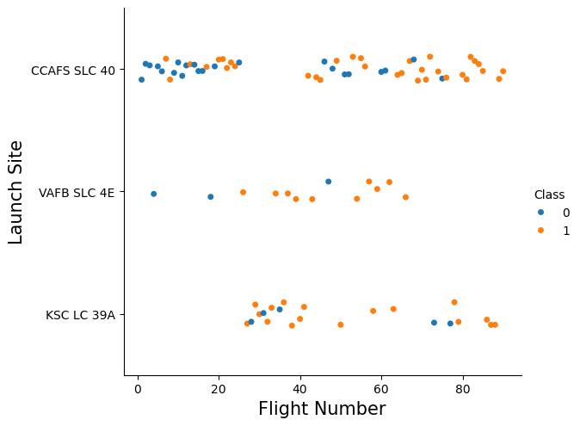
Flight Number vs. Launch Site
This scatter plot shows the FlightNumber in x and the Launch Site in y, with the hue representing the class (success or fail).
Indicates that the success rate incresease up to around the 30 flight number.

Slide 19
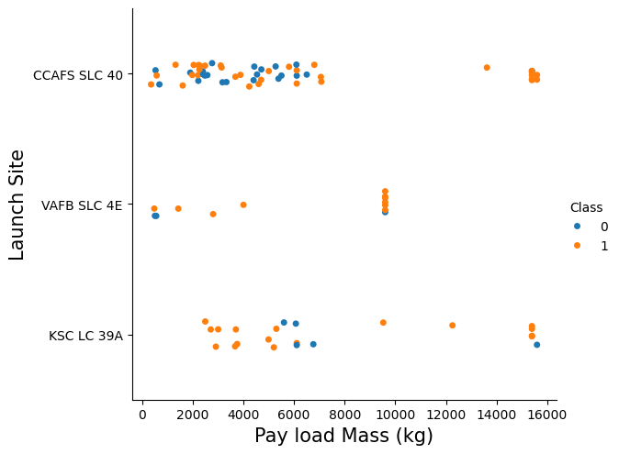
Payload vs. Launch Site
This scatter plot shows the Payload Mass in x and the Launch Site in y, with the hue representing the class (success or fail).
The only relationship between launch sites and their payload mass is that for the VAFB SLC 4E, there are no rockets launched for heavy payload (greater tan 10000).

Slide 20
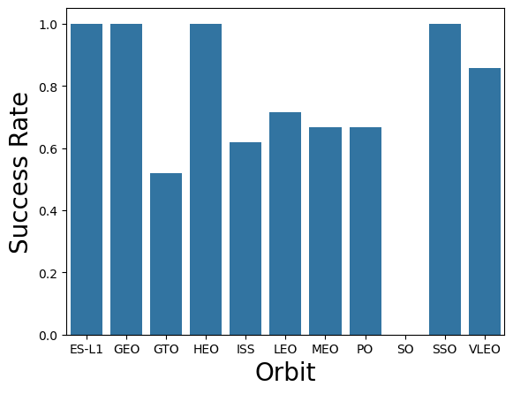
Success Rate vs. Orbit Type
This bar plot shows the Orbit in x and the Success Rate for each orbit in y, which is the mean of class (success or fail).
We can see that the ES-L1, GEO, HEO and SSO orbits have highest success rate while SO has no successful landings.

Slide 21
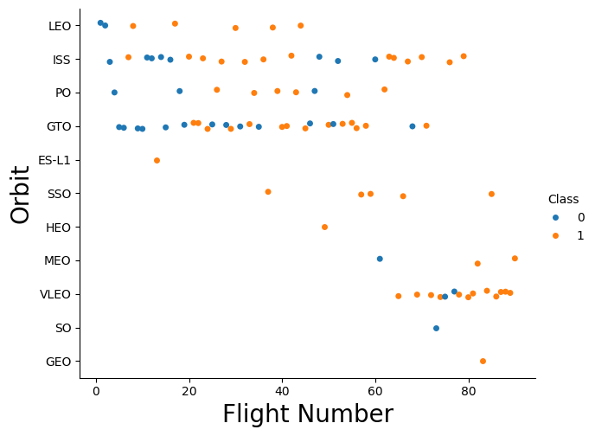
Flight Number vs. Orbit Type
This scatter plot shows the Flight Number in x and the Orbit in y, with the hue representing the class (success or fail).
We can see that mostly, the greater the fligth number, the greater the success rate, like with LEO. However, for example, there seems to be no relationship for GTO.

Slide 22
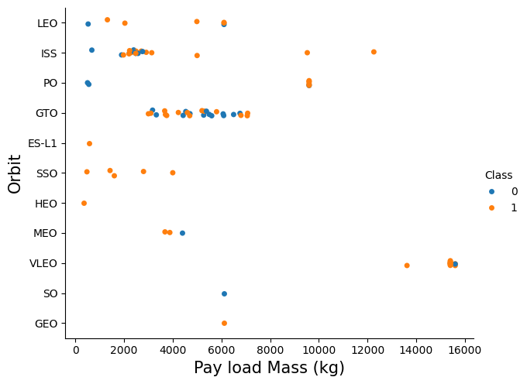
Payload vs. Orbit Type
This scatter plot shows the Payload mass in x and the Orbit in y, with the hue representing the class (success or fail).
With heavy payloads, the successful landing or positive landing rate is higher for Polar, LEO and ISS. However, for GTO we can’t discern this tren as both positive landing rates and negative outcomes are present.

Slide 23
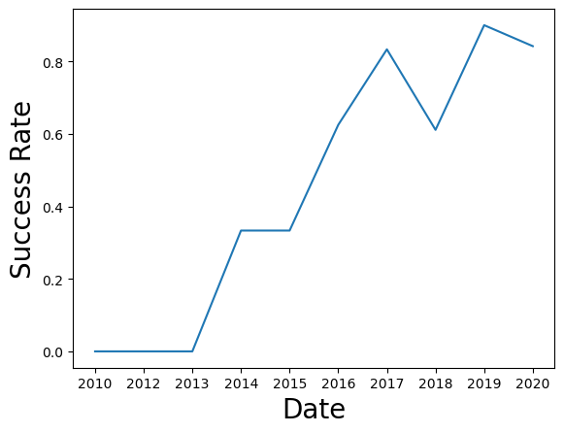
Launch Success Yearly Trend
This line chart shows the Date in x and the Success Rate in y, which is the mean of class (success or fail).
The chart clearly shows that the success rate since 2013 kept increasing till 2020.

Slide 24
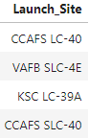
All Launch Site Names
SQL Query:
Description and output:
We used the DISTINCT function to find the all-unique Launch Site names from SPACEXTABLE

Slide 25
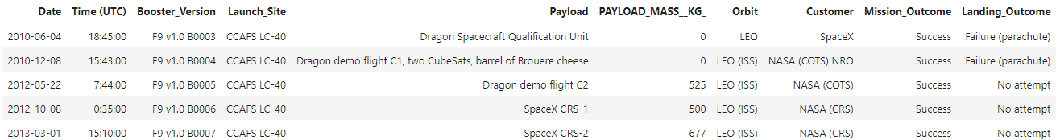
Launch Site Names Begin with 'CCA'
SQL Query:
Description and output:
We used the LIKE operator to filter the Launch Site which begin with ‘CCA’ and LIMIT operator to get only the first 5 records

Slide 26
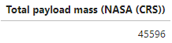
Total Payload Mass
SQL Query:
Description and output:
We used the SUM function to calculate the total Payload Mass carried by boosters from the Customer NASA(CRS). We have also renamed the result column for better understanding.

Slide 27
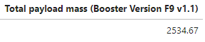
Average Payload Mass by F9 v1.1
SQL Query:
Description and output:
We used the AVG function to calculate the mean Payload Mass carried by Booster Version F9 V1.1. We have also used the ROUND function with 2 for better presentation and get only 2 decimals.

Slide 28
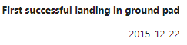
First Successful Ground Landing Date
SQL Query:
Description and output:
We used the MIN function to calculate the first successful Landing Outcome on ground pad. We have also renamed the result column for better understanding.

Slide 29
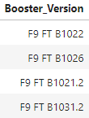
Successful Drone Ship Landing with Payload between 4000 and 6000
SQL Query:
Description and output:
We used the WHERE operator to get the Successful drone ship landings, then combined with AND operator so we get the Payload Mass BETWEEN 4000 and 6000 Kg, finally show the corresponding boosters.

Slide 30
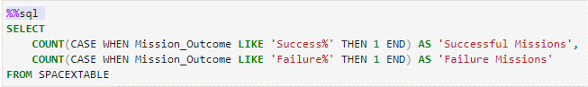
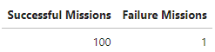
Total Number of Successful and Failure Mission Outcomes
SQL Query:
Description and output:
We used the CASE clause within the COUNT functions to calculate the total number of successful and failure Mission Outcomes, since their format is not unique. We have also renamed the result column for better understanding.

Slide 31
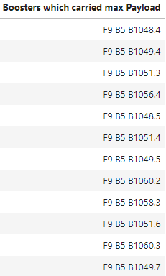
Boosters Carried Maximum Payload
SQL Query:
Description and output:
We used the MAX function in the sub-query to get the maximum Payload Mass. Then we SELECT the Booster version which have carried this Payload. We have also renamed the result column for better understanding.

Slide 32
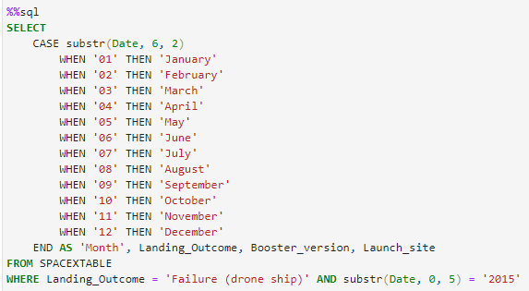
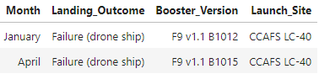
2015 Launch Records
SQL Query:
Description and output:
We used the WHERE operator to get the Failure drone ship landings, then combined with AND operator so we get the Date specifically filtered with substr(Date, 0, 5) to check if the year is 2015. Then, in the SELECT we use CASE with substr(Date, 6,2) to only print the Month name.

Slide 33
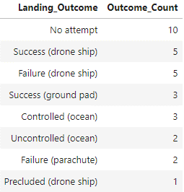
Rank Landing Outcomes Between 2010-06-04 and 2017-03-20
SQL Query:
Description and output:
We used the COUNT function to calculate total Landing Outcomes BETWEEN the date 2020-06-04 and 2017-03-20 GROUP BY Landing Outcome and ORDER BY the total outcome calculated in descending order.

Slide 34

Section 3

Slide 35
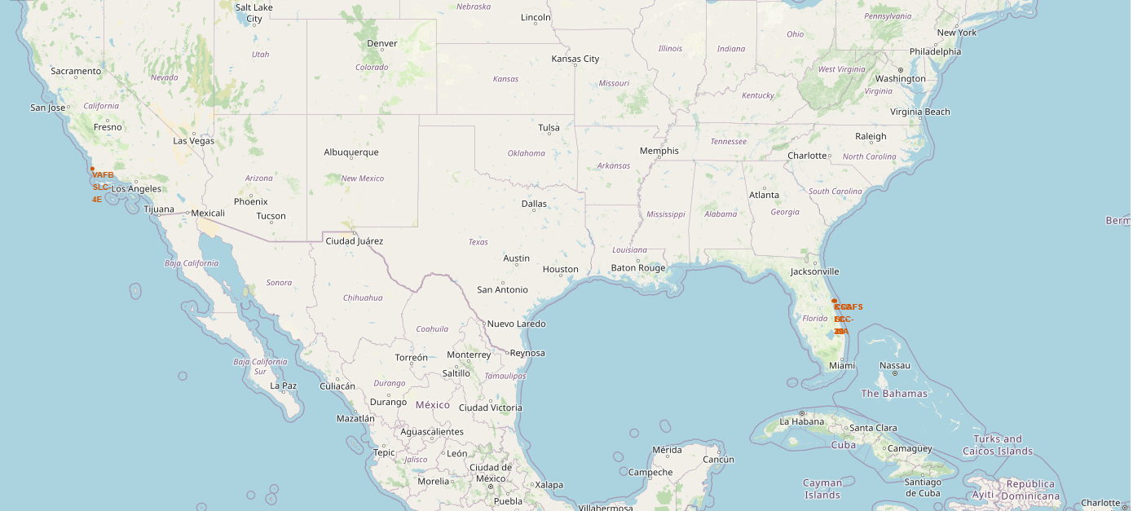
All Launch Sites on Folium Map
We can observe that all launch sites in the United States of America are very close to the coast and the close they can to the Equator line.

Slide 36
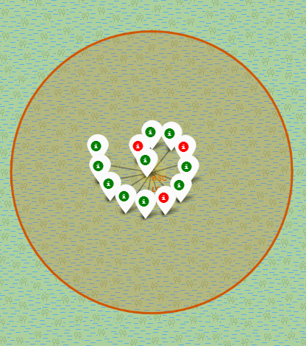
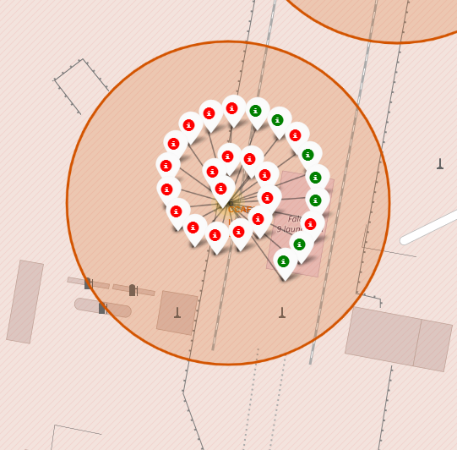
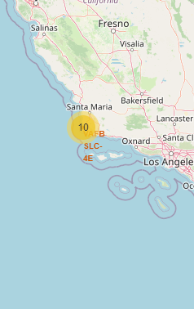
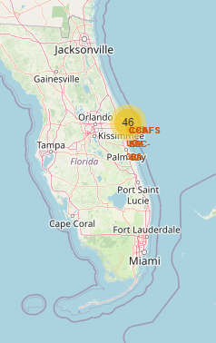
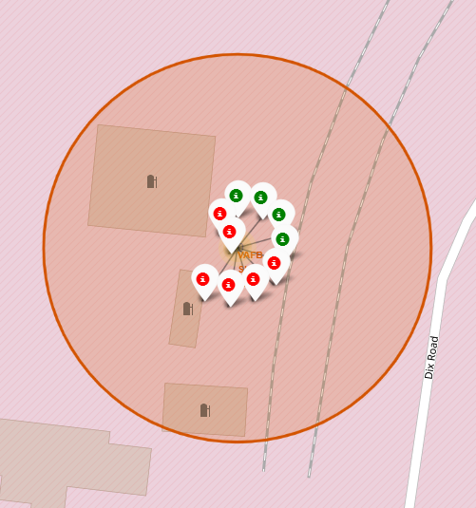
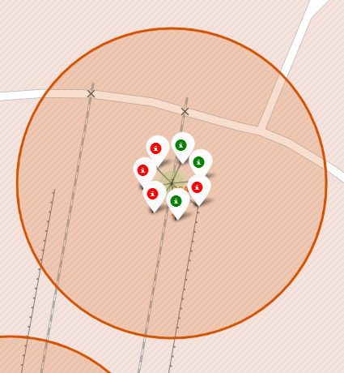
Markers for launch outcomes
The launch outcomes are represented in marker clusters for each launch site. We can zoom in and see specific markers, green for successful ones and red for failed ones. With this, the launch site with more probability of success is KSC LC-39A
KSC LC-39A
CCAFS LC-40
VAFB SLC-4E
CCAFS SLC-40

Slide 37
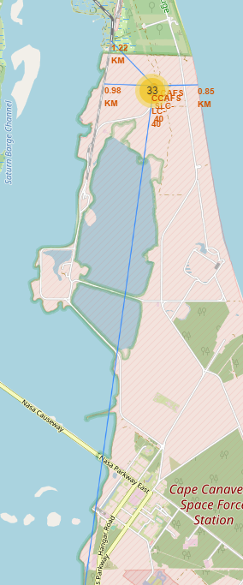
Distance between launch sites to landmarks
We calculated the distances between launch sites to railway, highway, coastline and cities.
Railroad
Are launch sites near railways?
Yes (e.g., 1.22 Km)
Are launch sites near highways?
Yes (e.g., 0,98 Km)
Are launch sites near coastline?
Yes (e.g., 0,85 Km)
Do launch sites keep certain distance away from cities?
Yes (e.g., 19,72 Km)
Coastline
Highway
City (Cape Canaveral)

Slide 38

Section 4

Slide 39
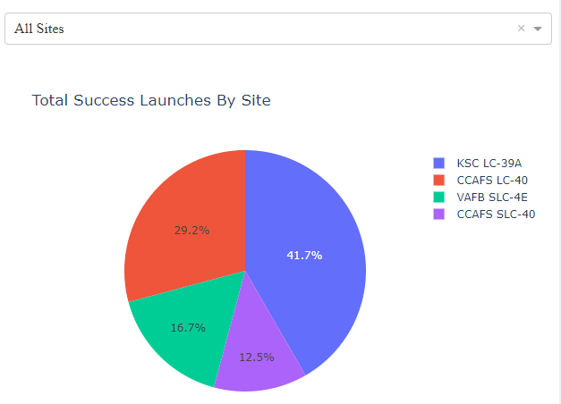
Launch success count of All Sites
We can easily observe that KSC LC-39A has the most successful launches rate from all the sites.

Slide 40
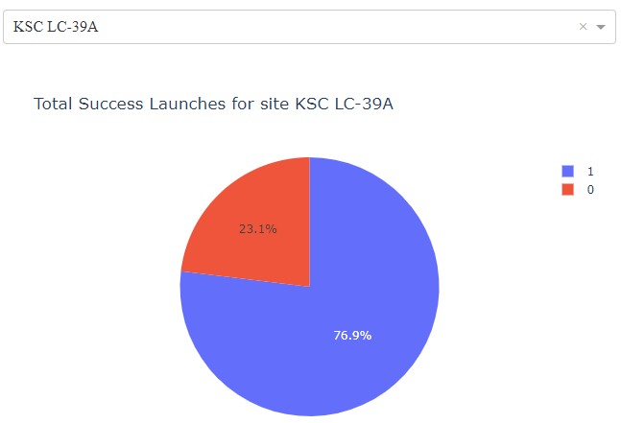
Launch Site with highest launch success ratio
We can identify from the specific pie chart of KSC LC-39A that has a 76.9% rate of successful launches

Slide 41
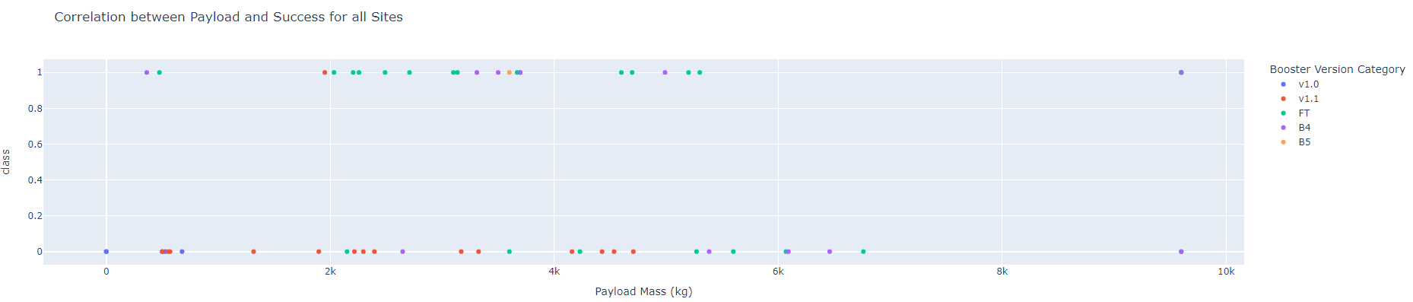
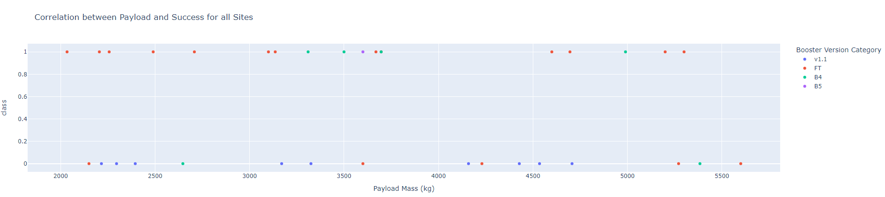
Payload vs. Launch Outcome for All Sites
With this dashboard we can observe these insights:
Payload range with highest launch success: 2000-6000 Kg
Booster version with highest launch success: FT

Slide 42

Section 5

Slide 43
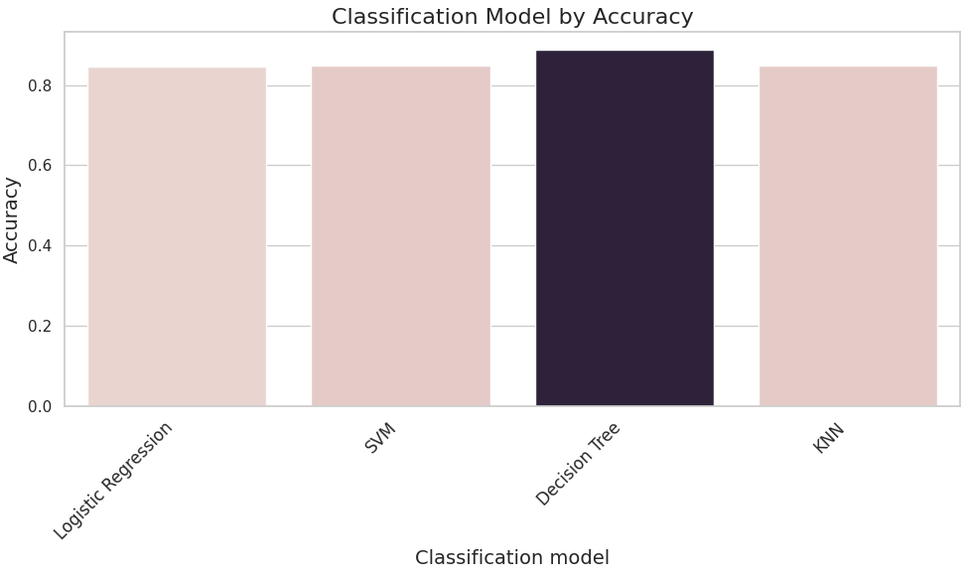
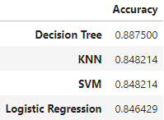
Classification Accuracy
We can identify in this bar chart and DataFrame that “Decision Tree” is the classification model with the highest accuracy.

Slide 44
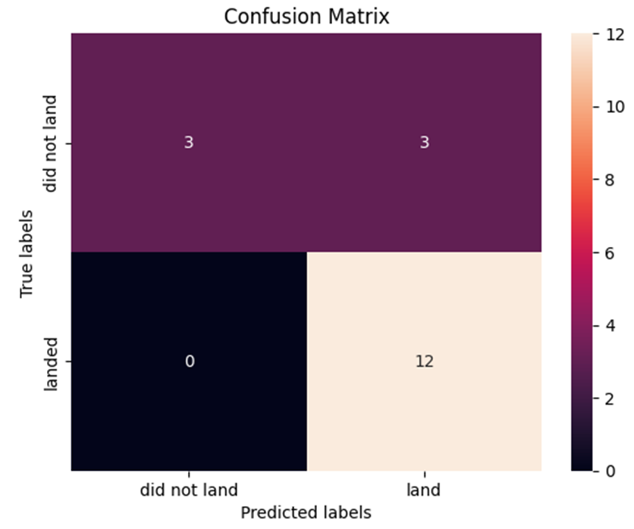
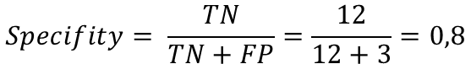
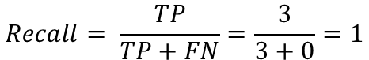
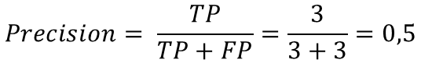
Confusion Matrix
Confusion matrix helps to determine the performance of a classification model by determining accuracy, precision, recall, specificity and F1 Score.
All classification models produced identical confusion matrices.
$$Precision= \frac{TP}{TP+FP}=\frac{3}{3+3}=0,5$$
$$Recall= \frac{TP}{TP+FN}=\frac{3}{3+0}=1$$
$$Accuracy= \frac{TP+TN}{TP+TN+FP+FN}=\frac{3+12}{3+12+3+0}=0,83$$
$$Specifity= \frac{TN}{TN+FP}=\frac{12}{12+3}=0,8$$
$F1 Score=2∗\frac{Precision∗Recazll}{Precision+Recall}=2∗\frac{0,5∗1}{0,5+1}=0,$67

Slide 45
Conclusions
The success rate have been increasing by the time since 2013.
The ES-L1, GEO, HEO and SSO orbits have the highest success rates.
KSC LC-39A is the most successful launch site.
The Payload range between 2000Kg and 6000Kg has the highest launch success.
F9 FT booster version has the highest launch success.
The Decision Tree is the best classification model for this problem.

Slide 46


